Slide 1


TEXT RECOGNITION AI
BY : J ADHESH

Slide 2
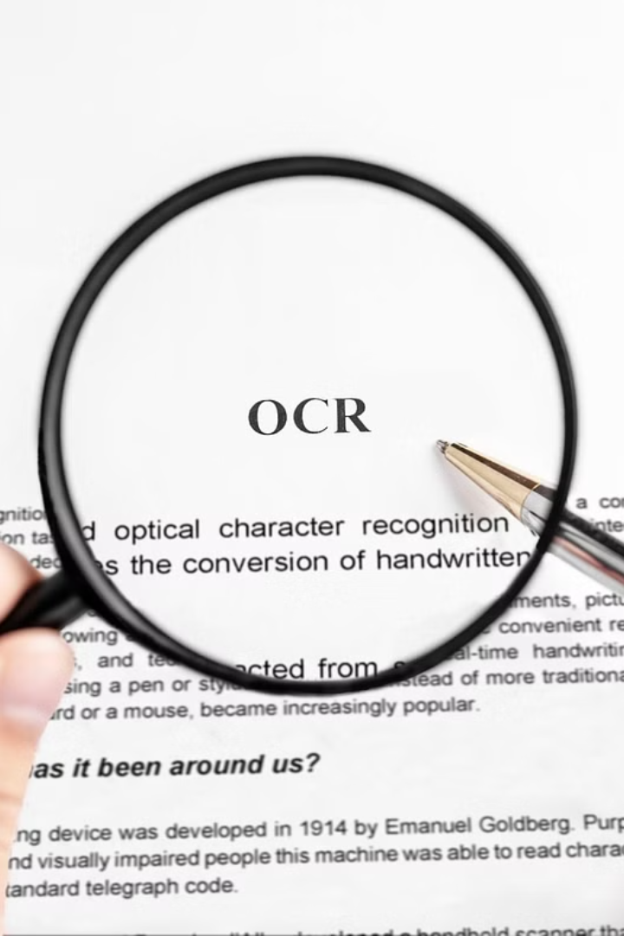
Introduction
Unlock the power of text recognition technology and dive into its transformative capabilities. From digitizing handwritten documents to automating data entry, this cutting-edge AI empowers businesses and individuals to revolutionize their workflows.

Slide 3
What is Text Recognition AI?
Automated Text Extraction
Intelligent Digitization
Broad Applications
This technology has applications in areas like document management, data entry, translation, and business process automation, to name a few.
Text Recognition AI utilizes computer vision and deep learning to automatically identify, extract, and digitize text from images, documents, or other visual media.
By converting text data into a machine-readable format, Text Recognition AI enables efficient digital processing, storage, and analysis of text-based information.

Slide 4




How does Text Recognition AI work?
Image Capture
Text Detection
Character Recognition
Output Generation
The first step is to capture an image containing text, often using a camera or scanner.
AI algorithms then analyze the image to locate and isolate the text regions.
Advanced machine learning models decode the shapes of individual characters within the text.
The recognized text is then output in a digital format, such as editable text or searchable PDFs.

Slide 5
Applications of Text Recognition AI
1
Document Digitization
Extracting text from scanned documents, books, and forms to create searchable digital archives.
2
Automated Data Entry
Populating databases and spreadsheets by extracting key information from forms, invoices, and other structured documents.
3
License Plate Recognition
Identifying vehicle license plate numbers for security, traffic monitoring, and toll collection applications.

Slide 6
Advantages of Text Recognition AI
1
Increased Efficiency
2
Improved Accuracy
Text recognition AI can rapidly process and extract text from large volumes of documents, saving time and resources compared to manual data entry.
Advanced algorithms and machine learning models enable text recognition AI to achieve high levels of accuracy, reducing errors and improving data quality.
3
Enhanced Accessibility
4
Streamlined Workflows
Text recognition AI can make printed materials more accessible to individuals with visual impairments by converting text to digital formats that can be read aloud or magnified.
By automating text extraction and indexing, text recognition AI can streamline various business processes, such as document management and data processing.

Slide 7
Challenges and Limitations of Text Recognition AI
Data Quality
Specialized Vocabularies
Language Complexity
Hardware Limitations
Inconsistent or low-quality data can impair the accuracy of text recognition algorithms, leading to errors and inaccuracies in the output.
Certain domains, such as medical or legal, may use specialized vocabularies that are difficult for generic text recognition models to accurately parse.
Complex language structures, like idiomatic expressions or contextual references, can pose challenges for text recognition systems, limiting their performance in certain scenarios.
The computational power and memory requirements of advanced text recognition models can be resource-intensive, limiting their deployment on lower-end devices.

Slide 8



Future Trends in Text Recognition AI
Multimodal Integration
1
Combining text recognition with other AI technologies
Contextual Understanding
2
Interpreting text within the broader context
Handwriting Recognition
3
Advancing capabilities for deciphering cursive and stylized writing
As text recognition AI continues to evolve, we anticipate exciting new developments on the horizon. Key trends include the integration of text recognition with other AI modalities, such as computer vision and natural language processing, to provide deeper contextual understanding. Additionally, advancements in handwriting recognition will enable the technology to interpret a wider range of writing styles with greater accuracy.

Slide 9



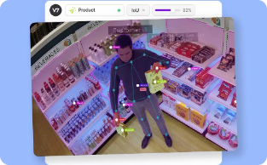
Case Studies and Success Stories
Automated Claims Processing
Digitizing Medical Records
Efficient Loan Processing
Optimizing Inventory Management
A large hospital system implemented Text Recognition AI to convert handwritten patient records to digital format, improving data accessibility and quality of care.
A financial institution leveraged Text Recognition AI to automate the extraction of key data from loan application forms, cutting processing times by 50%.
A major insurance company used Text Recognition AI to streamline their claims processing, reducing turnaround time by 40% and cutting operational costs by 25%.
A major retailer used Text Recognition AI to digitize and analyze product labels, enabling real-time inventory tracking and streamlining supply chain operations.

Slide 10
Ethical Considerations in Text Recognition AI
The widespread use of text recognition AI raises important ethical concerns around data privacy, algorithmic bias, and transparency. Careful consideration must be given to how this technology is deployed to protect individual rights and ensure it is used responsibly.
Key ethical issues include securing sensitive data, preventing misuse, and ensuring AI systems are fair and unbiased. Ongoing oversight and clear policies are needed to address these challenges as text recognition AI becomes more prevalent.

Slide 11
Conclusion and Key Takeaways
In conclusion, text recognition AI has emerged as a powerful technology with far-reaching applications. From digitizing printed documents to automating data entry, this technology has revolutionized the way we interact with textual information.
5
3
Key Benefits
Main Challenges
Text recognition AI offers increased efficiency, reduced errors, and enhanced accessibility for a wide range of industries and users.
Ongoing development is needed to address accuracy limitations, data privacy concerns, and the complexity of handling diverse text formats.
Looking ahead, the future of text recognition AI holds immense promise. Advancements in deep learning, natural language processing, and multimodal integration are expected to drive even more innovative applications and overcome current limitations.
By embracing this transformative technology, organizations and individuals can unlock new levels of efficiency, productivity, and accessibility in the digital age.

Slide 12

THANK YOU

